Slide 1
Group 4 10:45
Project 1

Slide 2

Group 4 10:45
Project 1

Slide 3
Table of Contents:
‣ Agenda
‣ To do list
‣ Project Planner
‣ 9 queries from individuals
‣ 9 queries as a group
‣The rest of everyone's queries

Slide 4
Agenda
‣ Get everyone familiar with the software we will be using
‣ Have each individual members craft 20 queries, ranging from simple to complex
‣ Create a Java application which takes in text queries and returns the results
‣ Cultivate a great team-working environment

Slide 5

To-Do-Lists
Lists from each contributing member:

Slide 6
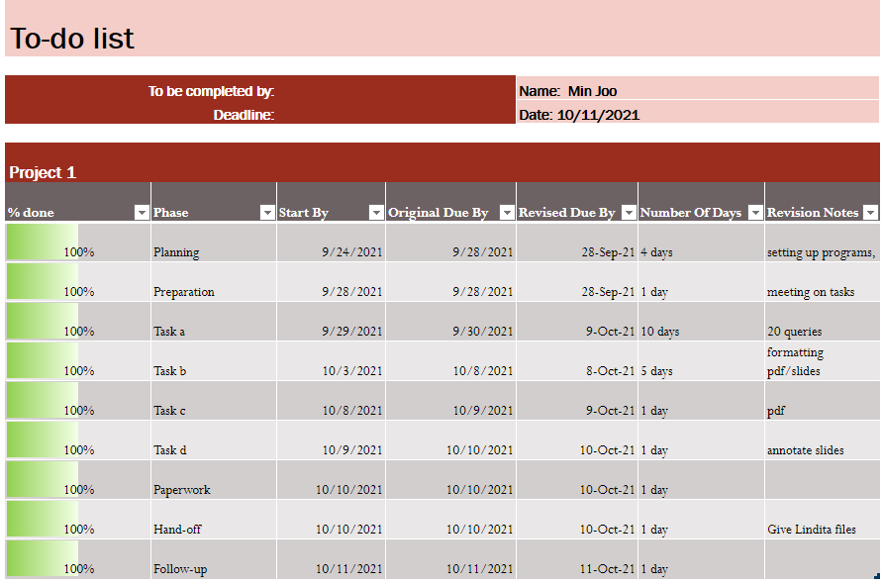
Min Joo to do

Slide 7
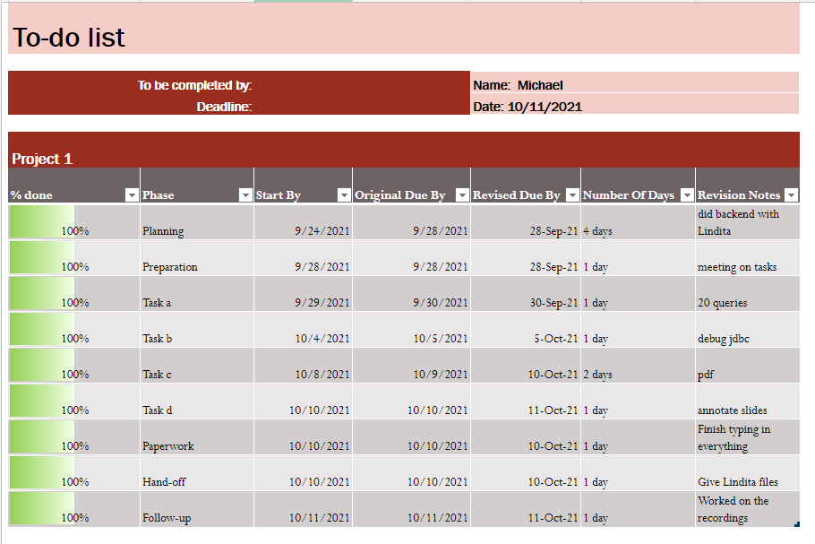
Michael to do

Slide 8
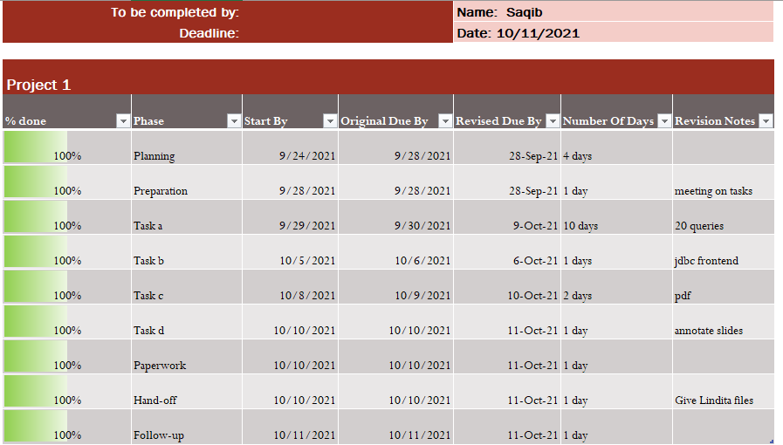
Saqib to do

Slide 9
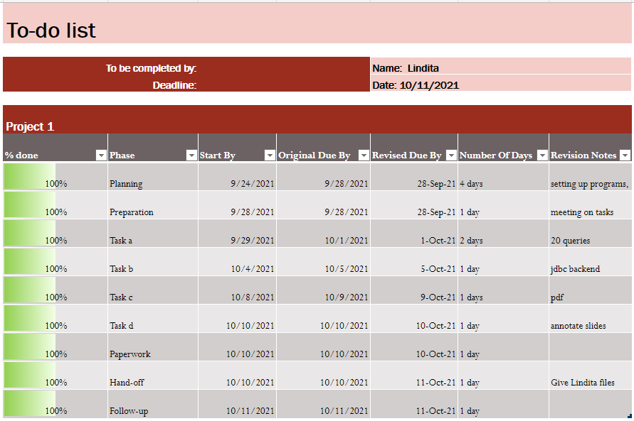
Lindita to do

Slide 10

Project Planner
How all of this was planned

Slide 11
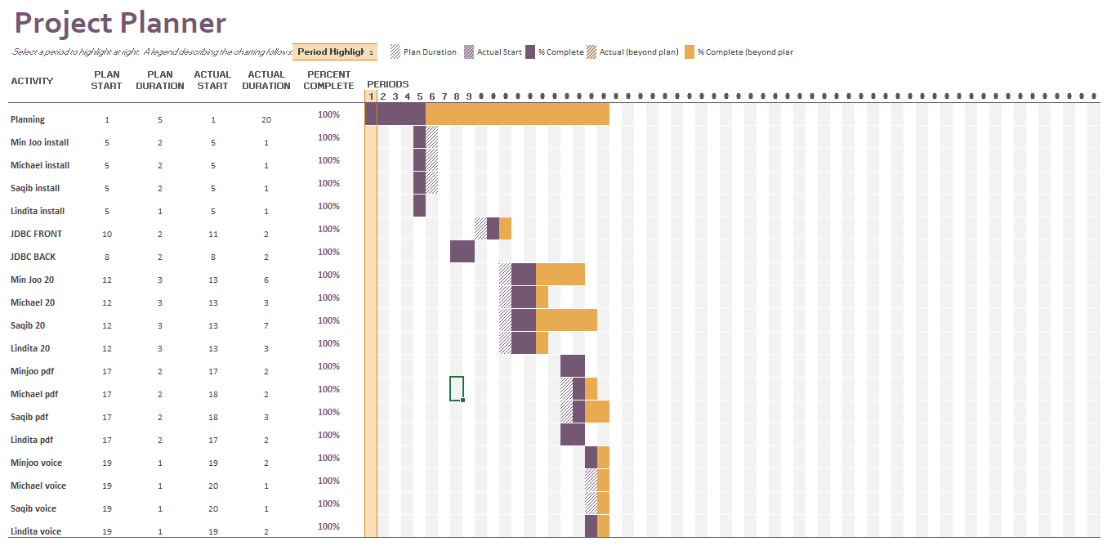
Gantt scheduling

Slide 12
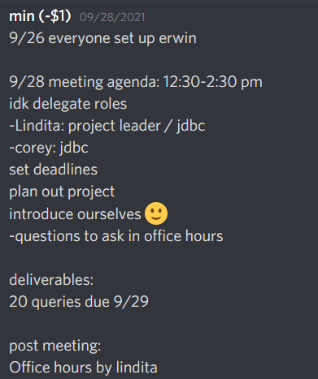
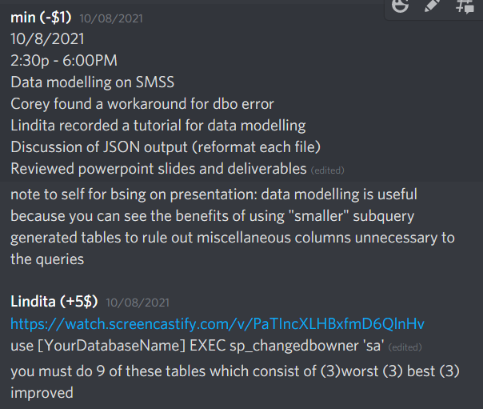

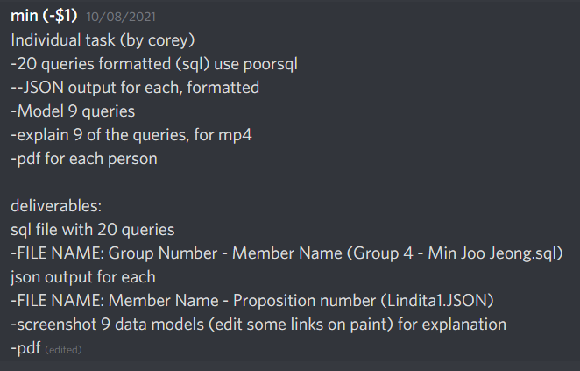
Discord meetings and
meeting notes
(voice call)
organization of server

Slide 13

Individual Propositions
9 queries from each group member

Slide 14
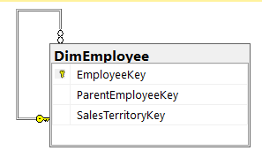
Min Joo - Proposition 1
Simple, Best
Proposition 1: Return employees assigned to Sales Territory 6 (AdventureWorksDW2017)
Figure 1A: Key View Model for Proposition 1

Slide 15
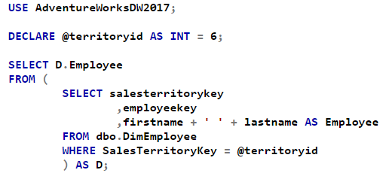
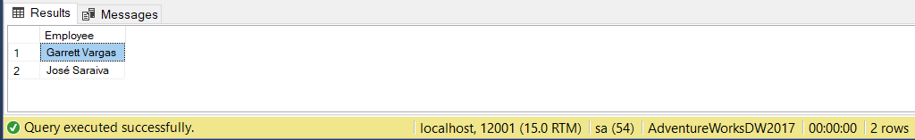
Min Joo - Proposition 1
Figure 1D: Formatted SQL Query for Proposition 1

Slide 16
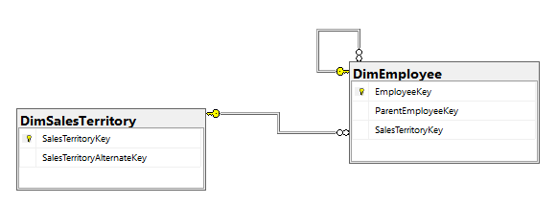
Min Joo - Proposition 2
Medium, Best
Returns the region for all the managerial staff (AdventureWorksDW2017)
Figure 2A: Key View Model for Proposition 2

Slide 17
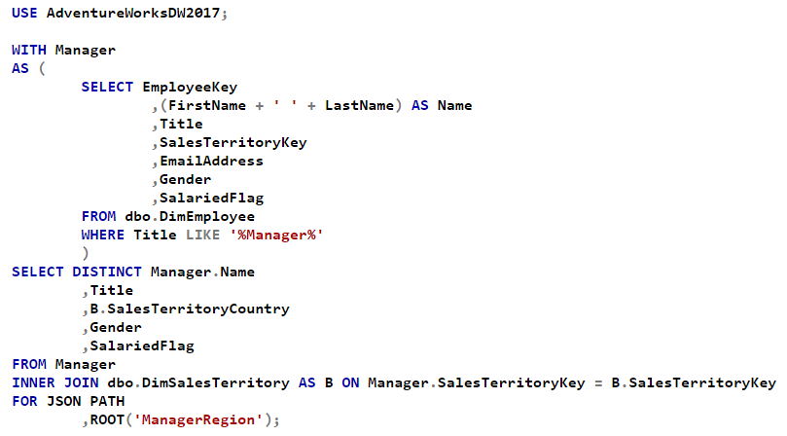
Min Joo - Proposition 2
Notes:
Best Medium query due to its efficient use of the common table expression to group managerial staff using their titles. I noticed that the table DimEmployee had a lot of repeats so select distinct was used. Necessary information like gender and if they were salaried were included for future and potential queries.

Slide 18
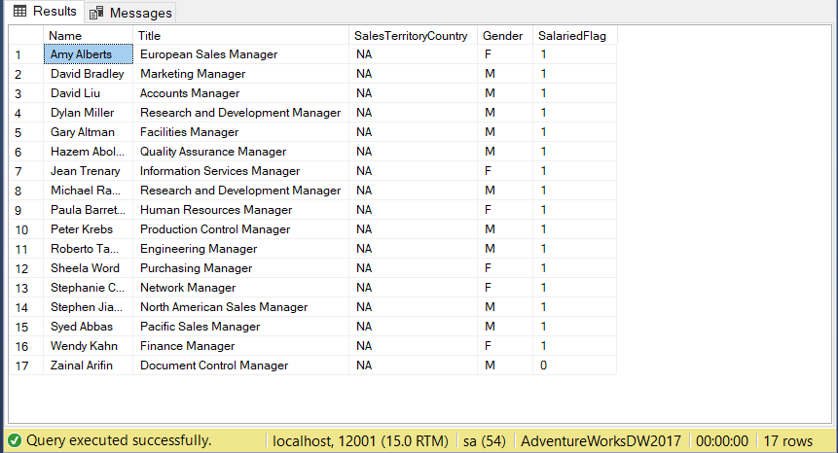
Min Joo - Proposition 2
Figure 2E: Query Output for Proposition 2

Slide 19
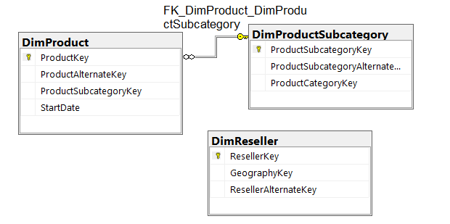
Min Joo - Proposition 3
Complex, Best Proposition 3: Bike shops with a potential list of products stocked based on their store type (AdventureWorksDW2017)
Figure 3A: Key View Model for Proposition 3
Notes:
AdventureWorksDW2017 was used again. My best queries ended up from AdventureWorksDW2017 because as Professor Heller said in class, the best queries come from familiarity with the database and this was the database I became most acquainted with.

Slide 20
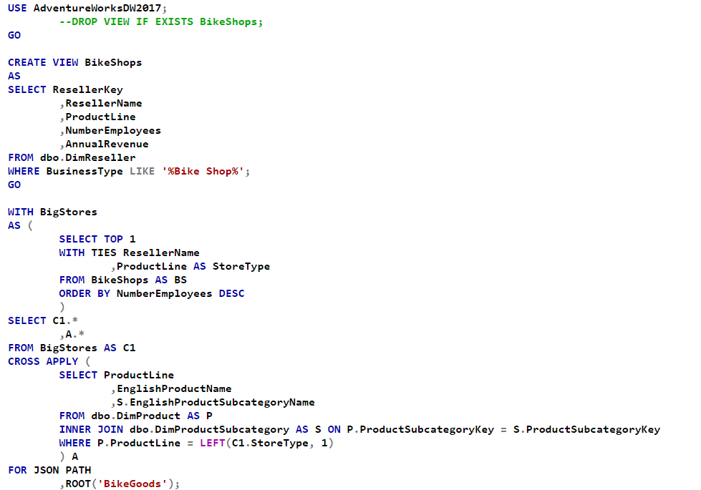
Min Joo - Proposition 3
Notes:
Best complex query because of its potential for future queries and its code legibility. I liked my dissection of the data in the tables and their formatting. The view “bike shop” was created for flexibility, such as using it to select only the biggest stores. It would also be useful for other potential queries. Since the ProductLine data input for Reseller and Product aren’t standardized, I had to truncate the description to its initial, like Road to R, Mountain to M, in order to join the tables. An additional join was created to Subcategory for product description. Using cross apply makes it explicit that each product is attributed to each bike store.

Slide 21
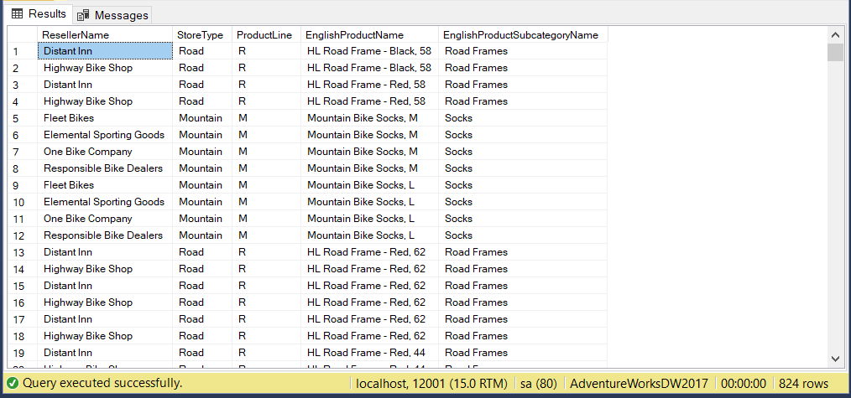
Min Joo - Proposition 3
Figure 3E: Query Output for Proposition 3

Slide 22
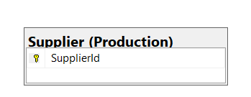
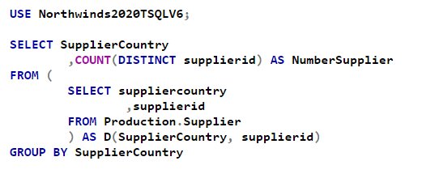
Min Joo - Proposition 4
Simple, Worst
Amount of suppliers from each country (Northwinds2020TSQLV6)
Figure 4A: Key View Model for Proposition 4
Notes:
Worst simple query. Despite using only one table and it 2 columns, it looks more complicated than necessary. The code is hard to follow with an unnecessary nested select statement. I grouped the two selected columns from the Supplier table as D but never used that table alias anyway.

Slide 23
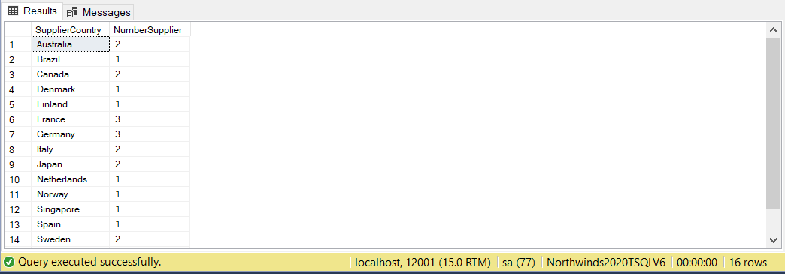
Min Joo - Proposition 4
Figure 4E: Query Output for Proposition 4
Notes:
It’s also the worst query because there’s no order to the amount returned. Poor execution and results.

Slide 24
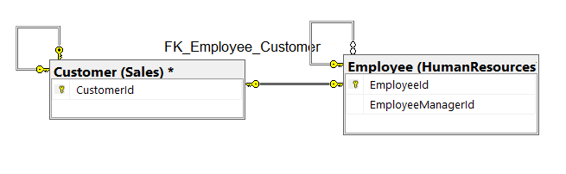
Min Joo - Proposition 5
Medium, Worst
Pair each UK Employee with a UK Customer Country (Northwinds2020TSQLV6)
Notes:
Sounds like it would’ve been preferable to use a cross join, but I didn’t.

Slide 25
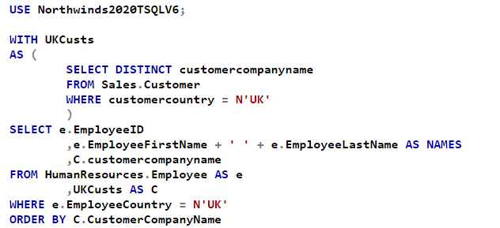
Min Joo - Proposition 5
Notes:
The pairing is done with select statement instead of a cross join or apply, so it’s rather unclear what is being accomplished in code due to lack of descriptors.
I used a CTE to classify UK customers, but it is a confusing code to follow since I didn’t group UK employees with one.

Slide 26
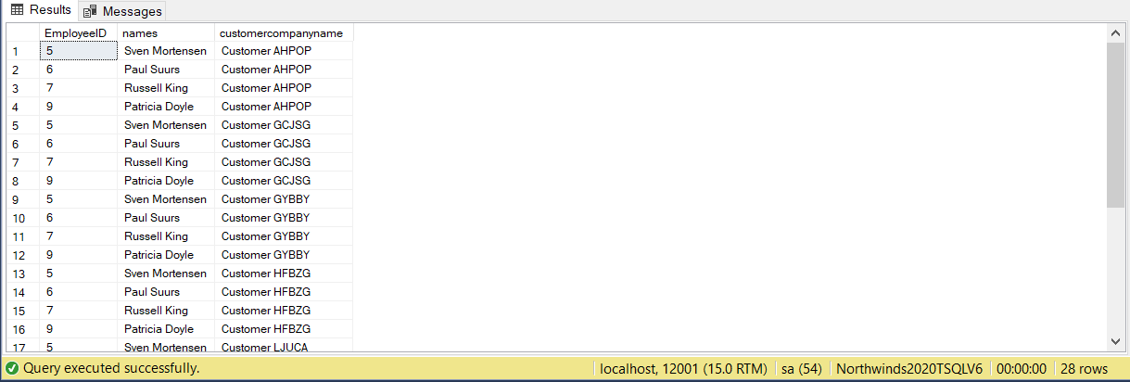
Min Joo - Proposition 5
Figure 5E: Query Output for Proposition 5

Slide 27
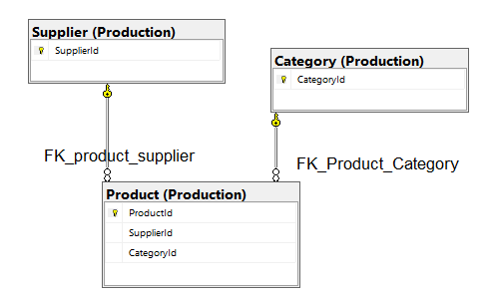
Min Joo - Proposition 6
Complex, Worst
Proposition 6: Average prices for each supplier with corresponding products (Northwinds2020TSQLV6)
Figure 6A: Key View Model for Proposition 6
Notes:
Average prices for each supplier, using corresponding products (described using Category table). Uses Production.Supplier, Production.Product with a join on supplierid).

Slide 28
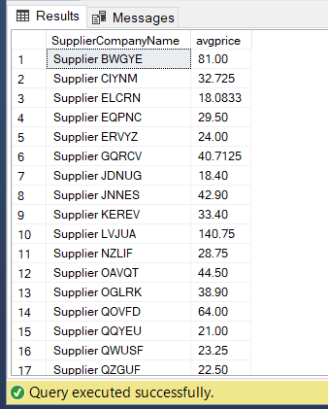
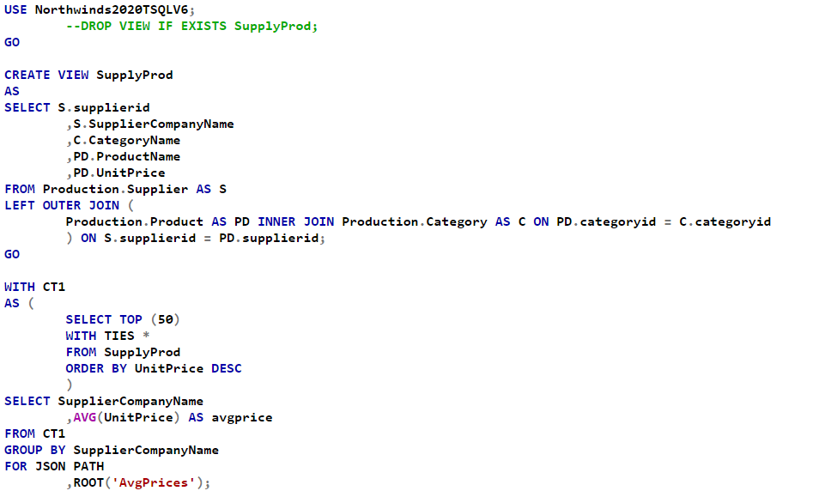
Min Joo - Proposition 6
Figure 6E: Query Output for Proposition 6
Notes:
The final select statement results in the output averaging the prices for each supplier.
This is a poorly executed query because while there is an Order by clause in the CTE (which is poorly labelled) and the top 50 most expensive products are selected, the final output isn’t organized by anything. Additionally, the execution is complicated with a view that is created prior, populated with largely unnecessary information.

Slide 29
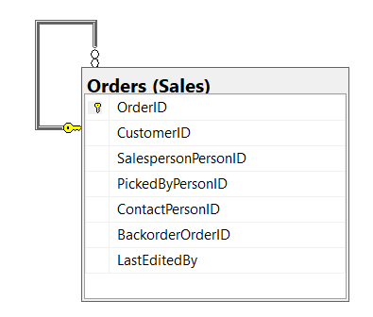
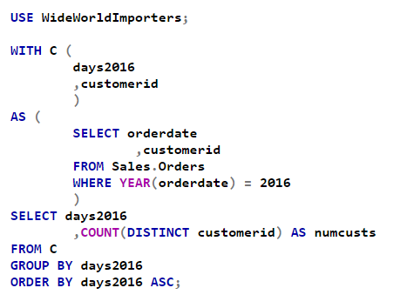
Min Joo - Proposition 7
Simple, Improved Count of unique customers for days in 2016 (WideWorldImporters)
Figure 7A: Key View Model for Proposition 7
Notes:
Use a CTE to simplify the processing of relevant data to find out the count of unique customers per day in 2016. It is an improved query because only relevant columns and information from Sales.Orders are kept with the CTE. COUNT of distinct customers is done in the query and the output is nicely ordered by date.

Slide 30
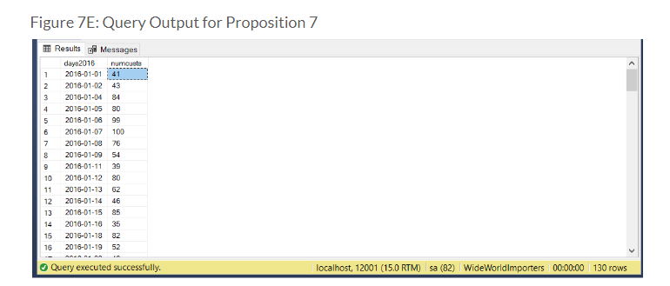
Min Joo - Proposition 7

Slide 31
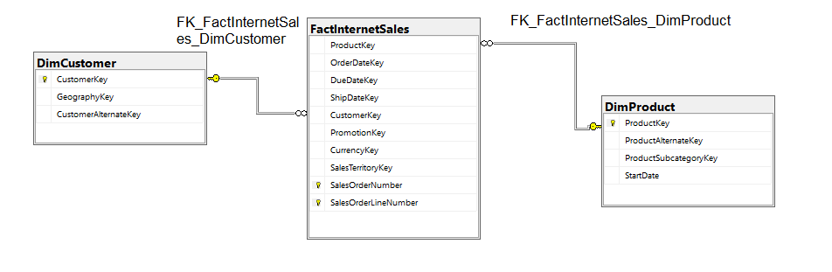
Min Joo - Proposition 8
Medium, Improved
Proposition 8: Descriptive result of 10 most recent internet orders from customers. (AdventureWorksDW2017)

Slide 32
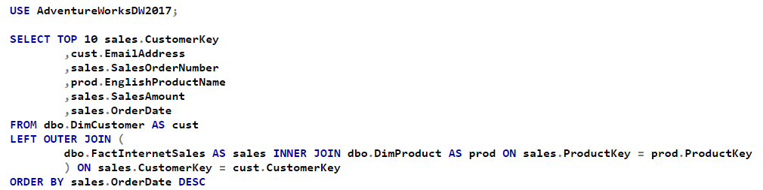
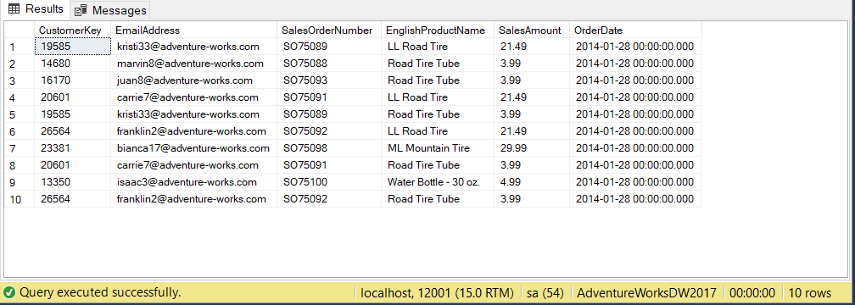
Min Joo - Proposition 8
Figure 8E: Query Output for Proposition 8
Notes:
I improved a previous query that returned more than 4000 rows of data which processed slowly and heavily. My computer actually froze. Now it returns 10 most recent internet orders from customers, with a description of products.

Slide 33
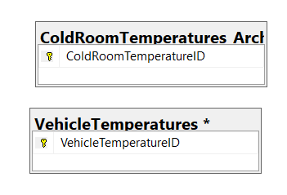
Min Joo - Proposition 9
Complex, Improved
Proposition 9: Daily average temperature of warehouse vehicle compared to overall average and average temperature of the cold room for each corresponding day (WideWorldImporters)
Figure 9A: Key View Model for Proposition 9

Slide 34
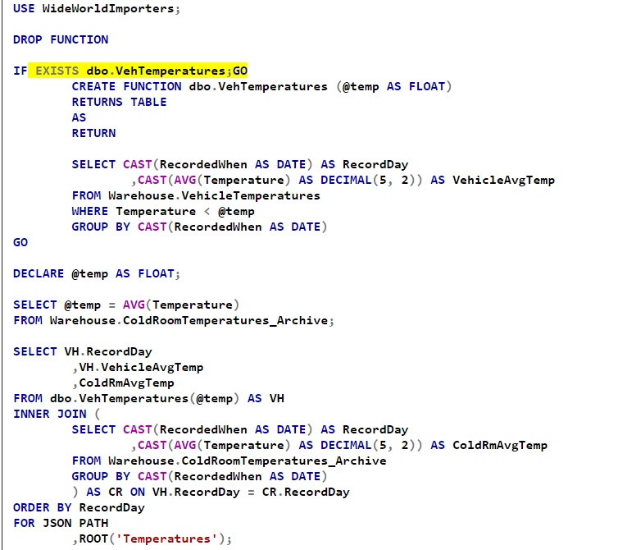
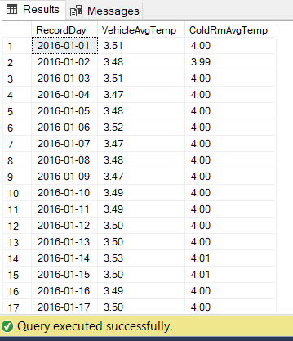
Min Joo -
Proposition 9
Figure 9E: Query Output for Proposition 9
Notes:
A function improved this query, as the implementation of a variable allows for flexibility in comparison. In this query, the variable is set to the overall average of the Vehicle temperature. The function compares and results in a table where the averaged daily temperature is less than the overall average. CAST is used to group multiple readings per day (then averaged), and it was an improvement since I used it to adjust decimal places for a standardized output. The averaged temperatures are then compared to the average daily ColdRoom temperatures, also adjusted using CAST.

Slide 35
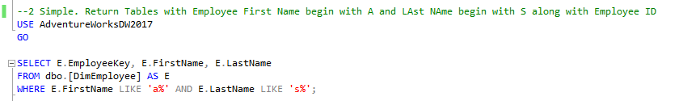
Michael - Proposition 1
Simple, Best
Return Tables with Employee First Name begin with A and Last Name begin with S along with Employee Key

Slide 36

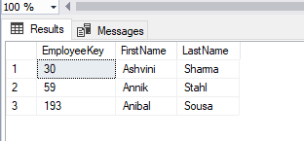
Michael - Proposition 1

Slide 37
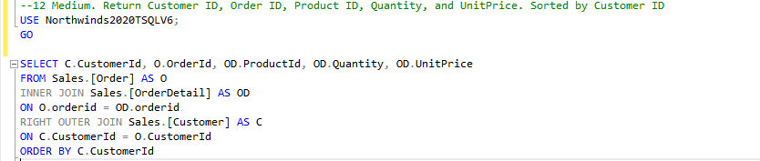
Michael - Proposition 2
Medium, Best
Return Customer ID, Order ID, Product ID, Quantity, and UnitPrice. Sorted by Customer ID

Slide 38
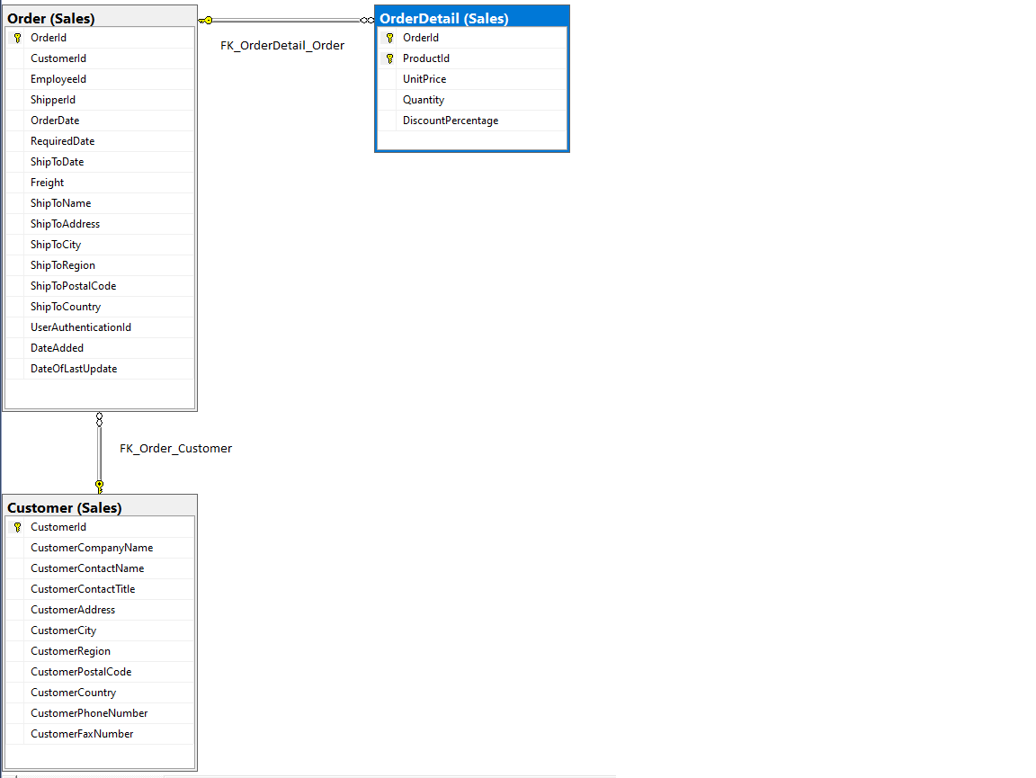
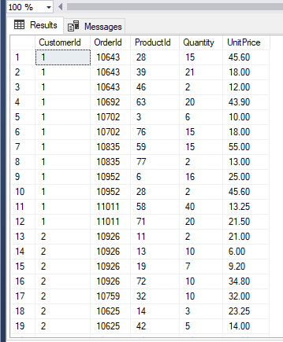
Michael - Proposition 2

Slide 39
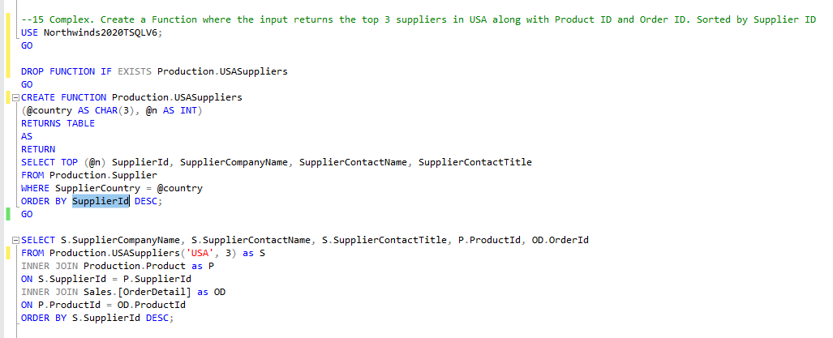
Michael - Proposition 3
Complex, Best
Create a Function where the input returns the top 3 suppliers in USA along with Product ID and Order ID. Sorted by Supplier ID

Slide 40
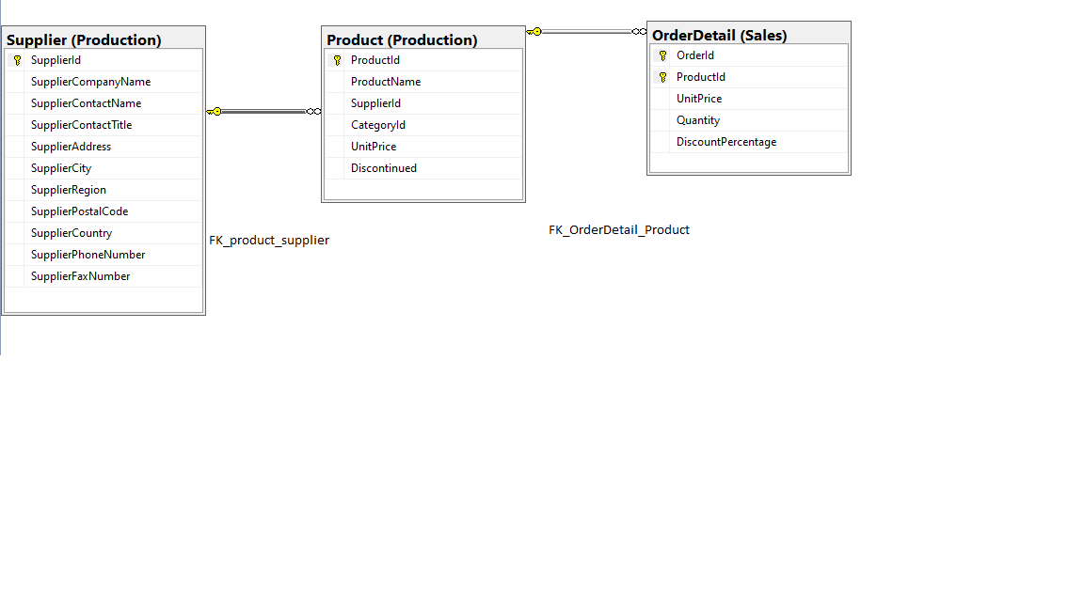
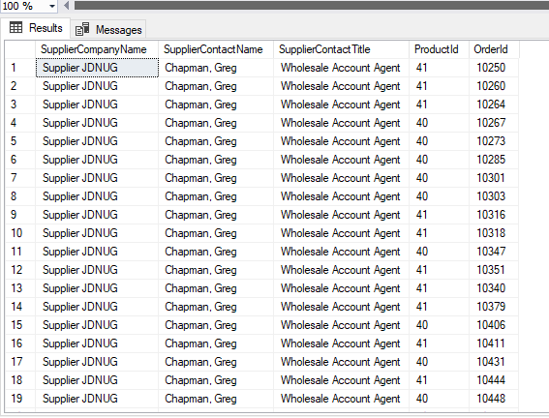
Michael - Proposition 3

Slide 41
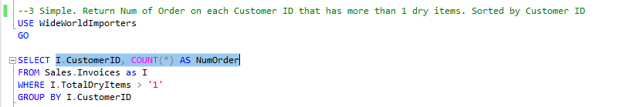
Michael - Proposition 4
Simple, Worst
Return Num of Order on each Customer ID that has more than 1 dry items. Sorted by Customer ID

Slide 42
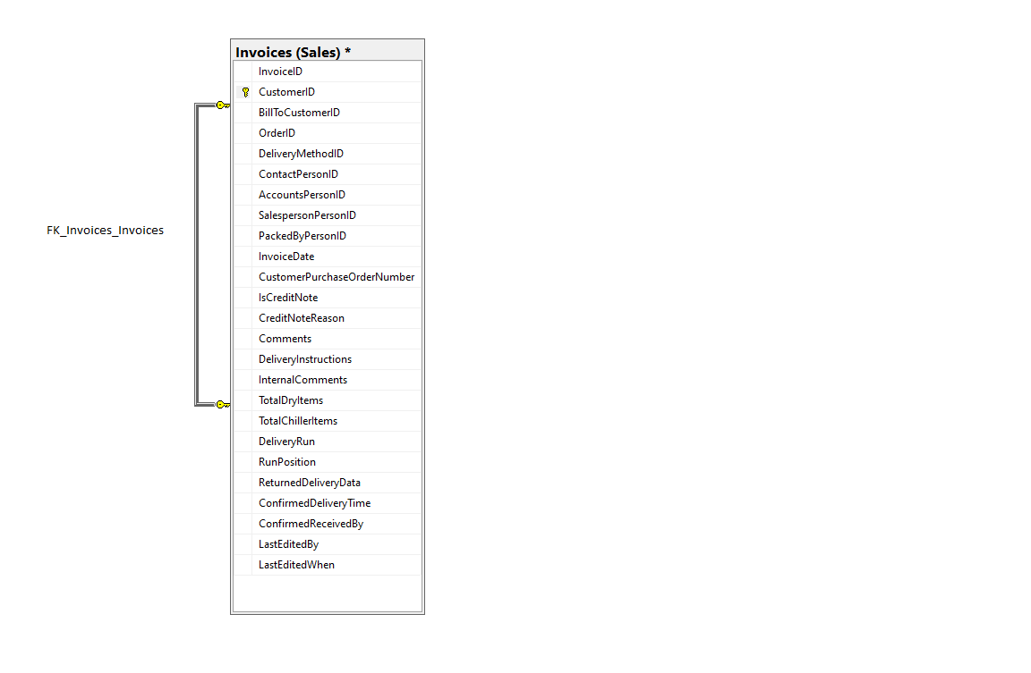
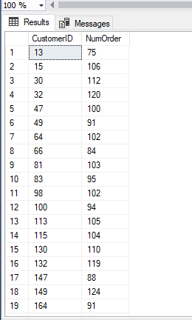
Michael - Proposition 4

Slide 43
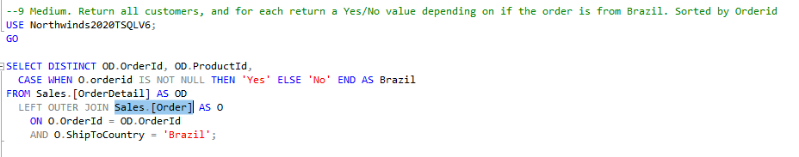
Michael - Proposition 5
Medium, Worst
Return all customers, and for each return a Yes/No value depending on if the order is from Brazil. Sorted by OrderId

Slide 44
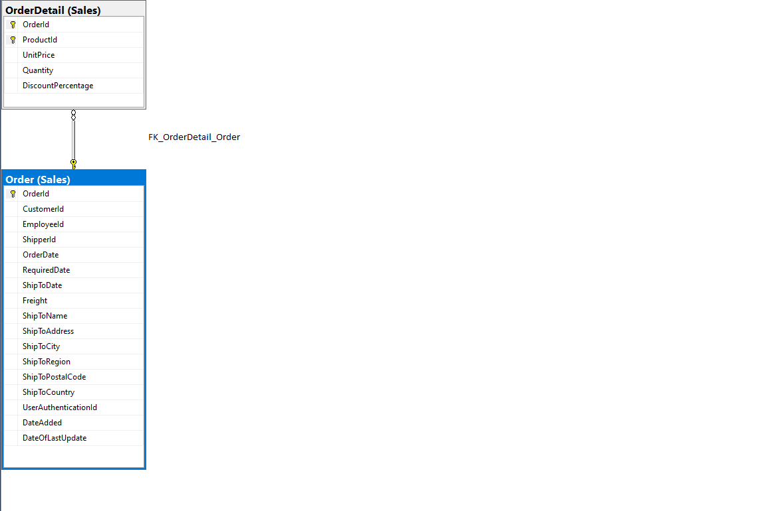
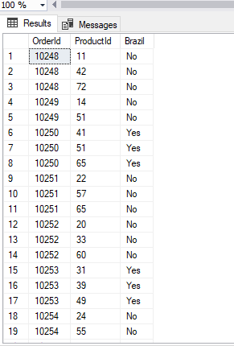
Michael - Proposition 5

Slide 45
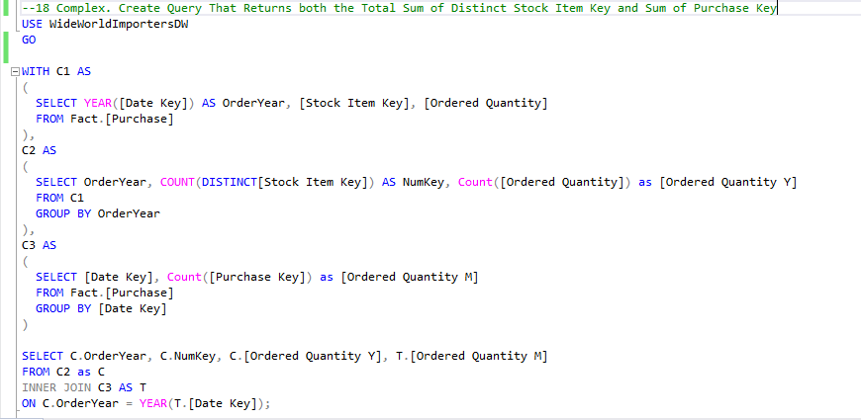
Michael - Proposition 6
Complex, Worst
Create Query That Returns both the Total Sum of Distinct Stock Item Key and Sum of Purchase Key

Slide 46


Michael - Proposition 6

Slide 47

Michael - Proposition 7
Simple, Improved
Create a Query that takes in SalesQuota that is Greater Than 200000 and Less Than 300000.

Slide 48


Michael - Proposition 7

Slide 49

Michael - Proposition 8
Medium, Improved
Return orders on Argentina along with Total Quantity. Sorted by OrderId

Slide 50


Michael - Proposition 8

Slide 51

Michael - Proposition 9
Complex, Improved
Create Function where you input first and last name and it returns the title. birth date, address, postal code, country, phone number, orderid and discount percentage. Sorted by OrderID

Slide 52


Michael - Proposition 9

Slide 53

Saqib - Proposition 1
Simple, Best
This query’s goal is to find out the cities that Employee 6 has packed to. This resulted in 40 different cities being delivered packages packed by Employee 6.

Slide 54


Saqib - Proposition 1

Slide 55

Saqib - Proposition 2
Medium, Best
Show me the total order amount
and amount spent from January 1 2012 to January 1 2013

Slide 56


Saqib - Proposition 2

Slide 57

Saqib - Proposition 3
Complex, Best
Show me who ordered the shark slippers, get the customer and their phone number. Only get customers who aren't businesses.

Slide 58


Saqib - Proposition 3

Slide 59

Saqib - Proposition 4
Simple, Worst
Show me the BusinessEntityID of people living in Ballard

Slide 60


Saqib - Proposition 4

Slide 61

Saqib - Proposition 5
Medium, Worst
Show me Full Name of customers whose credit cards expire after February 2007

Slide 62


Saqib - Proposition 5

Slide 63

Saqib - Proposition 6
Complex, Worst
Show me which customers ordered a Front Derailleur for their bikes

Slide 64


Saqib - Proposition 6

Slide 65

Saqib - Proposition 7
Simple, Improved
Show me the name of the products with the most quantity

Slide 66


Saqib - Proposition 7

Slide 67

Saqib - Proposition 8
Medium, Improved
Show me the largest to smallest orders along with the weight of the order

Slide 68


Saqib - Proposition 8

Slide 69

Saqib - Proposition 9
Complex, Improved
Show customer 30, see if they belong to the US region
and show which employee helped.

Slide 70


Saqib - Proposition 9

Slide 71

Lindita - Proposition 1
Simple, Best
Show work orders where products have been scrapped (greater than 70) and the reason as to why

Slide 72


Lindita - Proposition 1

Slide 73
Lindita - Proposition 2
Medium, Best
Show all single male potential buyers with an income greater than 100000 and match them up with the youngest single female employees
(shown on next page, it is very long)

Slide 74



Slide 75


Lindita - Proposition 2

Slide 76
Lindita - Proposition 3
Complex, Best
Find caleb F carter and give me information on his properties and taxes he paid over each year
(shown on next page)

Slide 77



Slide 78


Lindita - Proposition 3

Slide 79

Lindita - Proposition 4
Simple, Worst
Show the top 5 items where you have the most stock on hand

Slide 80


Lindita - Proposition 4

Slide 81

Lindita - Proposition 5
Medium, Worst
show all discontinued orders customer 5 placed

Slide 82


Lindita - Proposition 5

Slide 83
Lindita - Proposition 6
Complex, Worst
Get customer 4s latest order, when the order was picked, the expected delivery, check the warehouse and if its late
(shown on next page)

Slide 84


Slide 85


Lindita - Proposition 6

Slide 86

Lindita - Proposition 7
Simple, Improved
Show the top 5 items where we have the most stock on hand and the total price

Slide 87


Lindita - Proposition 7

Slide 88

Lindita - Proposition 8
Medium, Improved
Show all discontinued orders customer 5 placed and show amount

Slide 89

Lindita - Proposition 8

Slide 90
Lindita - Proposition 9
Complex, Improved
Find out what happened with customer 4s latest order and show when the order was picked and expected delivery and check the warehouse for quantity.
(Shown on Next page)

Slide 91


Slide 92

Lindita - Proposition 9

Slide 93

Group
Propositions
Group voted 9 queries

Slide 94
Saqib - Proposition 1
Simple, Best
This query’s goal is to find out the cities that Employee 6 has packed to. This resulted in 40 different cities being delivered packages packed by Employee 6.

Slide 95
Saqib - Proposition 1

Slide 96
Michael - Proposition 2
Medium, Best
Return Customer ID, Order ID, Product ID, Quantity, and UnitPrice. Sorted by Customer ID

Slide 97
Michael - Proposition 2

Slide 98
Lindita - Proposition 3
Complex, Best
Find caleb F carter and give me information on his properties and taxes he paid over each year
(shown on next page)

Slide 100
Lindita - Proposition 3

Slide 101
Min Joo - Proposition 4
simple, worst
Amount of suppliers from each country (Northwinds2020TSQLV6)

Slide 102
Saqib - Proposition 5
medium, worst
Show me Full Name of customers whose credit cards expire after February 2007

Slide 103
Saqib - Proposition 5

Slide 104
Lindita - Proposition 6
Complex, Worst
Get customer 4s latest order, when the order was picked, the expected delivery and check the warehouse
(shown on next page)

Slide 106
Lindita - Proposition 6

Slide 107
Min Joo - Proposition 7
simple, improved
Count of unique customers for days in 2016 (WideWorldImporters)

Slide 108
Saqib - Proposition 8
Medium, improved
Show me the largest to smallest orders along with the weight of the order

Slide 109
Saqib - Proposition 8

Slide 110
Lindita - Proposition 9
Complex, Improved
Find out what happened with customer 4s latest order and show when the order was picked and expected delivery and check the warehouse for quantity.
(Shown on Next page)

Slide 112
Lindita - Proposition 9

Slide 113

Rest of
Propositions
All the propositions that were excluded from the 9 individual and 9 group

Slide 114

Min Joo - Proposition 10

Slide 115

Min Joo - Proposition 11

Slide 116

Min Joo - Proposition 12

Slide 117

Min Joo - Proposition 13

Slide 118

Min Joo - Proposition 14

Slide 119

Min Joo - Proposition 15

Slide 120

Min Joo - Proposition 16

Slide 121



Min Joo - Proposition 17

Slide 122


Min Joo - Proposition 18

Slide 123


Min Joo - Proposition 19

Slide 124


Min Joo - Proposition 20

Slide 125

Michael - Proposition 10

Slide 126

Michael - Proposition 11

Slide 127

Michael - Proposition 12

Slide 128

Michael - Proposition 13

Slide 129

Michael - Proposition 14

Slide 130

Michael - Proposition 15

Slide 131

Michael - Proposition 16

Slide 132

Michael - Proposition 17

Slide 133

Michael - Proposition 18

Slide 134

Michael - Proposition 19

Slide 135


Michael - Proposition 20

Slide 136

Saqib - Proposition 10

Slide 137

Saqib - Proposition 11

Slide 138

Saqib - Proposition 12

Slide 139

Saqib - Proposition 13

Slide 140

Saqib - Proposition 14

Slide 141

Saqib - Proposition 15

Slide 142

Saqib - Proposition 16

Slide 143

Saqib - Proposition 17

Slide 144

Saqib - Proposition 18

Slide 145

Saqib - Proposition 19

Slide 146

Saqib - Proposition 20

Slide 147

Lindita - Proposition 10

Slide 148

Lindita - Proposition 11

Slide 149

Lindita - Proposition 12

Slide 150

Lindita - Proposition 13

Slide 151

Lindita - Proposition 14

Slide 152

Lindita - Proposition 15

Slide 153

Lindita - Proposition 16

Slide 154

Lindita - Proposition 17

Slide 155


Lindita - Proposition 18

Slide 156

Lindita - Proposition 19

Slide 157


Lindita - Proposition 20

